Slide 1
COVERTIX
Document protection- Classification Tool
Concept / Detailed Design
December 2015

Slide 2
Update Tracking
Editor Name | Affected Slides | Date | Update | #
 |  |  |  | 1
 |  |  |  | 2
 |  |  |  | 3
 |  |  |  | 4
 |  |  |  | 5

Slide 3
Table of Content
System Goals
Users Profile
Objectives
Users Main Tasks
Workflow
User Requirements
UI Specific Requirements
Task Analysis
Concept

Slide 4
Agenda
Expert evaluation- Presenting learning conclusion
Basic concept aspects
Optional concept for documents security level taging:
Main Screen- Classification
Sub screens- Policy
Search other policy
Policy data
change

Slide 5
Out of Today’s Scope
Detailed Design
Graphic Design
Terminology
Notes:
הקדמה להצגת הקונספט
כאן כדאי להזכיר שלא מדובר בעיצוב גרפי, או בעיצוב לוגי פרטני והטרמינולוגיה כאן אינה סופית.
בנוסף, אם יש נושאים/תחומים שהקונספט לא מתייחס אליהם בשלב

Slide 6
System Goals
Operative alignment between file contexts and classification
Accessible and effectively file security managing- inner/ external/ shared etc.
Creating a simple tagging process
Creating a file classification tool that displays the most important and minimum information the user needs for security tagging
Applicable classification (up to 7 levels)
From bar
From tool
Default policy- file character/ users/ actions possible/
Choose other policy

Slide 7








User Profile- Resource Manager/ Project Manager
Characteristics
Age 20-70
Academic Education
Level of Expertise in the system: medium-high
Computer Proficiency – high
Motivation – medium-high
Pain Point – System Complexity
Main device – Desktop
User’s Goal
Company employees/ lowers/ designers/banks etc.
Job Description
Creating documentation in different platforms (mainly Office programs) and subjects. Different classification levels and policy type
Work Environment
Typical office environment – cubicles, permanent artificial lighting. Surroundings are changing from quite to load (depends on amount of people in a shift), working in the same computer station optional.
Future option as a multiplatform. The main device definition – Desktop.

Slide 8
Security tagging tool- Objectives
Creating a separate tool addition to all optional computer file systems
Simplifying the process
Creating clarification of the policy details
Accessibility
Simplicity
Clarity

Slide 9
Users Main Tasks
Creating file
Right click
Review Classification option- up to 7 levels
Enter tool
Top bar
View details
A default file policy presented- changes between each classification
Classification tool
Choose other policy
Approve/save
View details- users; optional actions
Approve

Slide 10


הגדרת הרזולוציה
Resolution
מצגת זו
1366 X 768
16:9
1024 X 768
4:3
1920X 1080
16:9

Slide 11
Concept

Slide 12
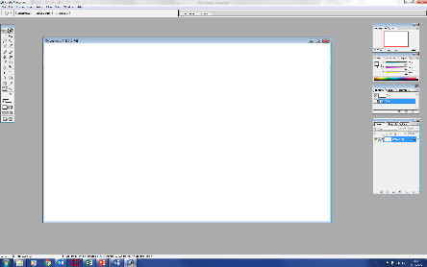

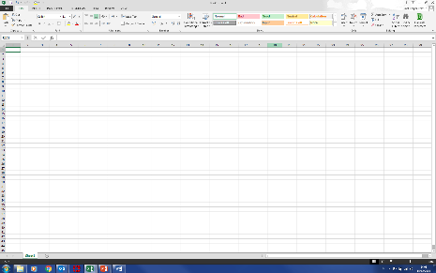
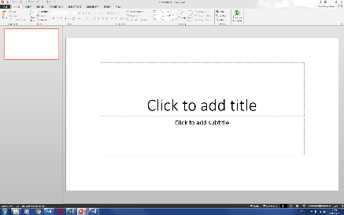
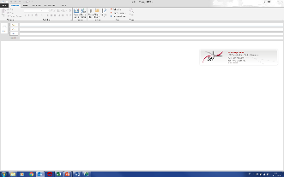
Optional platforms

Slide 13
Leading Concept Principles
Visual Visual Visual – presentation and interaction
Engaging User Experience
Simple and intuitive to use
Minimum mouse clicks
Similar Layout in all modules

Slide 14
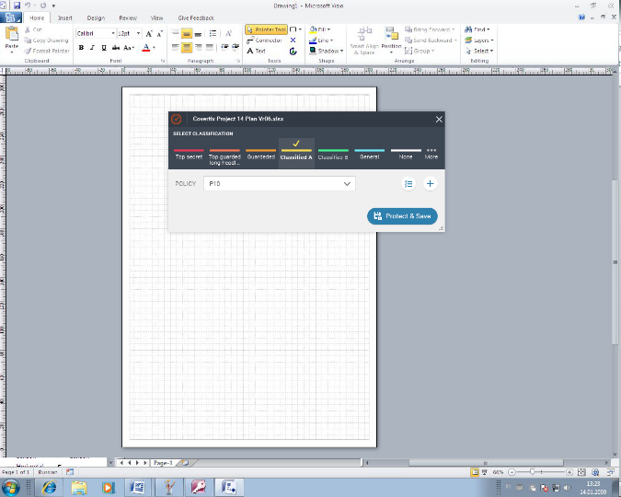
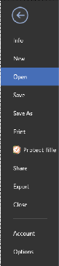
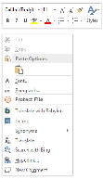

Right Click
Will show the option- “Protect File”
Right Click or through “File list”
Will show the option- “Protect File”

Slide 15
Popup Option

Slide 16
If there are more Classification “more menu” will be added for additional options
Choosing “Protect File” from maim manu or right click- will open a popup window - with the system predefined default for Classification & Policy
Choosing “Protect File” will open a popup window - with the system predefined default for Classification & Policy

Slide 17
Policy details- Policy Details control - will open more information on the current Policy
Creating new policy
P1
P4
P5
P6
P7
Changing Policy from a Predefined list suitable for the chosen classification
Changing Classification will automatically change to the connected default policy

Slide 18
Changing Classification will automatically change to the connected default policy
Changing Classification will automatically change to the connected default policy

Slide 19
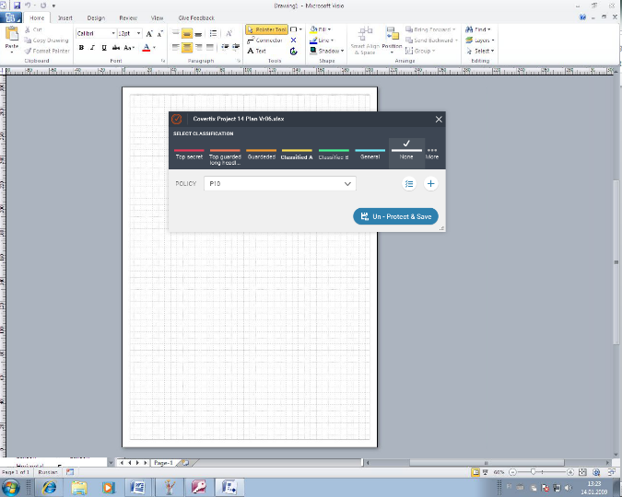

Slide 20
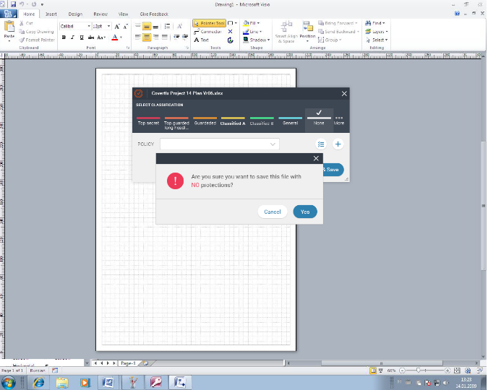
When Policy changed to “None” a message will appeared

Slide 21
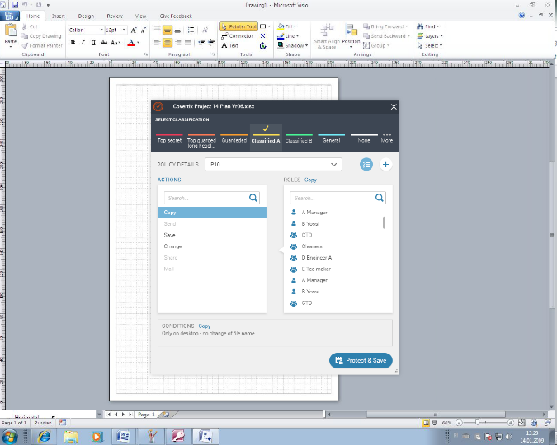
Classification bar is full
Policy details

Slide 22
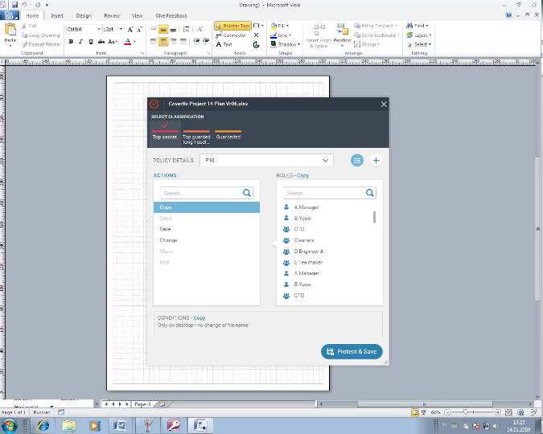
Short Classification bar
Policy details

Slide 23
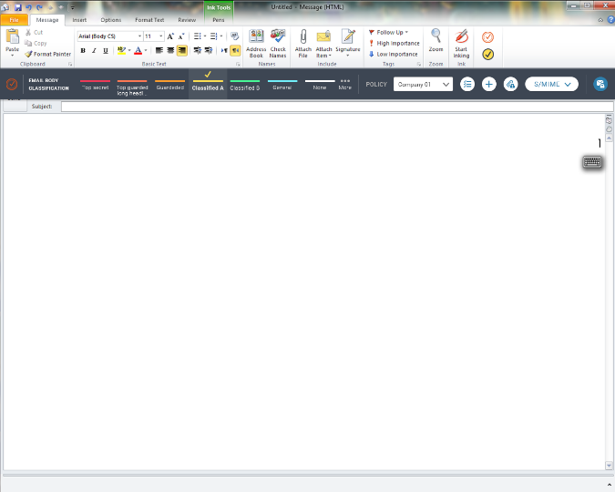
Policy name
Protect Mail
Classification bar is full up to 7 levels
Policy details
Add new Policy
Mail attachments Classification and Policy

Slide 24
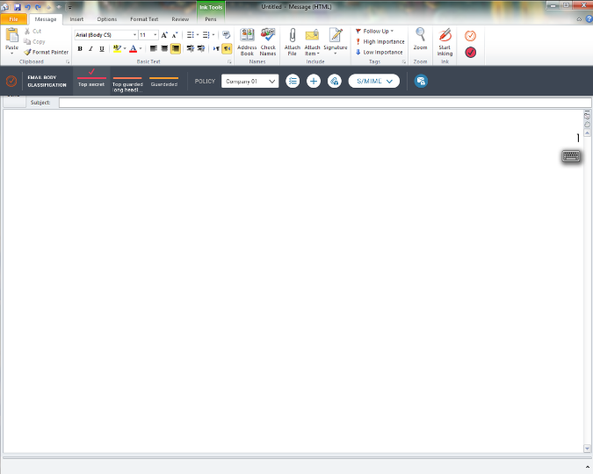
Short Classification bar

Slide 25
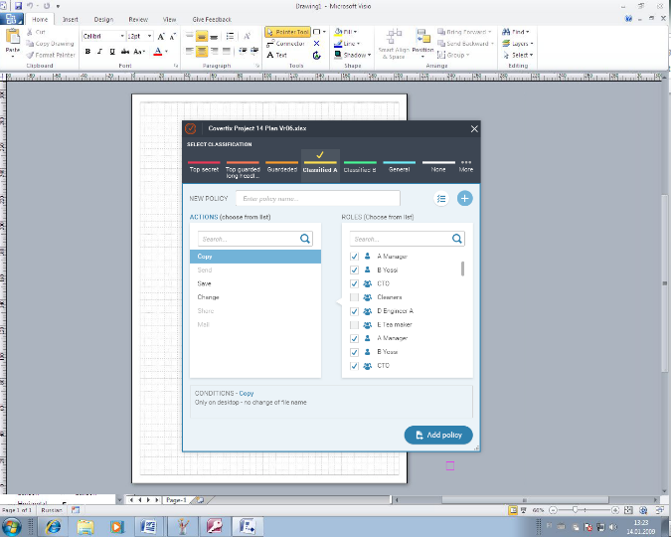
X- will close window with out saving
יאפשר פתיחת חלון נפרד להוספת אנשים חדשים אל הרשימה
New policy name will be added to policy list

Slide 26
Auto complete when creating a new name. Choosing from exist will change the details accordingly
Mo
Will be as a Toggle between the two options
Morgan
Moon
Mo
m
במידה ויבחר לעריכה POLICY קיים הרשימה תתעדכן על פי הקיימים וניתן יהיה להוסיף חדשים
במידה ויבחר לעריכה POLICY קיים הרשימה תתעדכן על פי הקיימים וניתן יהיה להוסיף חדשים

Slide 27
Bar Option in document

Slide 28
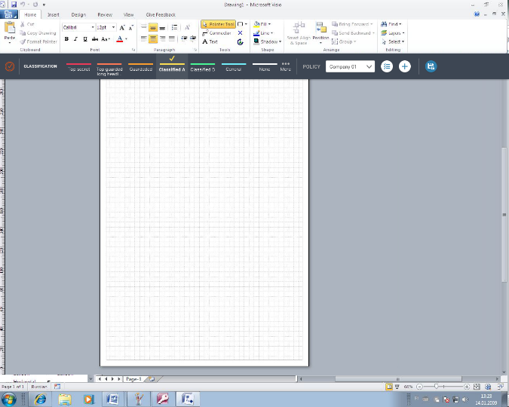
Classification bar-0
Will show the different options
The option selected
The default policy attached
An “other” option for changing policy

Slide 29



Slide 30
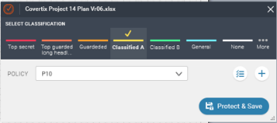
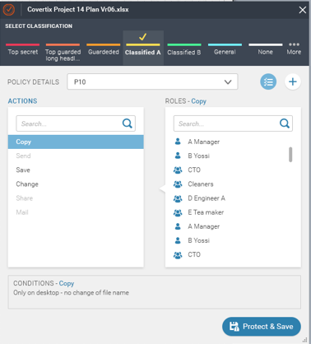

Slide 31
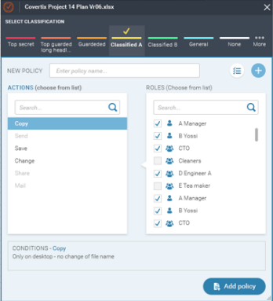

Slide 32
Mail – Bar Options

Slide 33
Open protection options
Send- will open popup for protection before sending mail

Slide 34
Protect attachments
P1
P4
P5
P6
P7
Protect & send
Classification bar
Policy Details
Add new policy

Slide 36
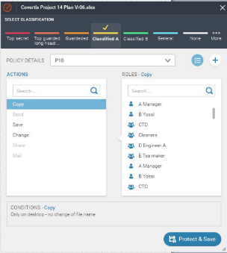

Slide 37
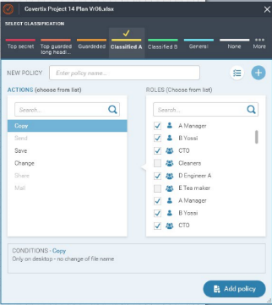
Add new people into ROLES list- will open a separate dialog
Will able to search a specific role inside the existing list. Will “search” and show results after click on the magnifying
When creating a new policy the ROLE window will open empty

Slide 39
Mail – Attachments options
One attachment editing

Slide 40

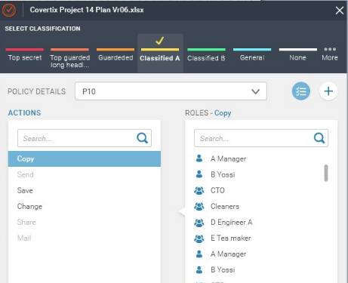
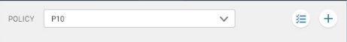

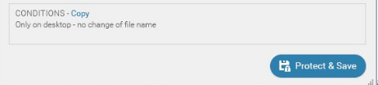


Mail Subject
Editing one attachment
ATTACHMENT CLASSIFICATION
Open mail attachments calcification editing
ALL
ATTACHMENT NAME
POLICY
Finale Version_slide_28…
P10
email_bar_slide_41_04
P3
HLD Covertix v8 after GUI concept …
Open source
Long files names will appear with three dots
A tooltip will appear by mouse hover and will show the full name
Re-Protect & Save

Slide 41
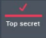
Mail Subject
Editing one attachment
ATTACHMENT CLASSIFICATION
ALL
ATTACHMENT NAME
POLICY
Finale Version_slide_28…
P10
email_bar_slide_41_04
P3
HLD Covertix v8 after GUI concept …
Open source
Click on different Classification and re protect and save will save the change
Click on different Classification and re protect and save will save the change
P3
Re-Protect & Save

Slide 42
Mail Subject
ATTACHMENT CLASSIFICATION
ATTACHMENT CLASSIFICATION
✓
ALL
ATTACHMENT NAME
POLICY
Editing attachment with no protection
Finale Version_slide_28…
P10
email_bar_slide_41_04
P3
HLD Covertix v8 after GUI concept …
Open source
Re-Protect & Save

Slide 43
Mail Subject
ATTACHMENT CLASSIFICATION
ATTACHMENT CLASSIFICATION
✓
ALL
ATTACHMENT NAME
POLICY
Editing attachment with no protection
Finale Version_slide_28…
P10
email_bar_slide_41_04
P3
HLD Covertix v8 after GUI concept …
Open source
Pressing the edit the POLICY control-– an change box will be active- (an arrow will appear)
A dropdown will open with other suitable options for POLICYs
Pressing the edit the POLICY control-– an change box will be active- (an arrow will appear)
A dropdown will open with other suitable options for POLICYs
P1
P4
P5
P10
P7
Re-Protect & Save

Slide 44
Mail Subject
ATTACHMENT CLASSIFICATION
ATTACHMENT CLASSIFICATION
✓
ALL
ATTACHMENT NAME
POLICY
Finale Version_slide_28…
P10
email_bar_slide_41_04
P3
HLD Covertix v8 after GUI concept …
Open source
P1
P4
P5
P10
P7
Save the new C &P
Re-Protect & Save

Slide 45
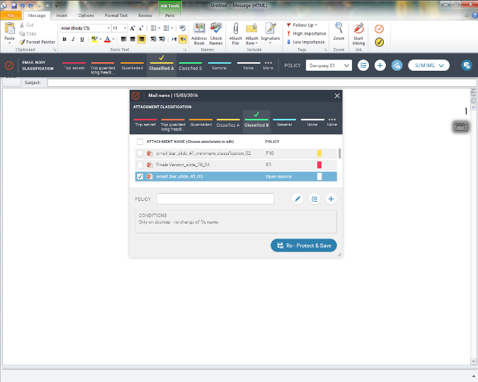
P10
Re protect & save the changes
בשמירה ישתנו השינויים
בשמירה ישתנו השינויים
בשמירה ישתנו השינויים

Slide 46
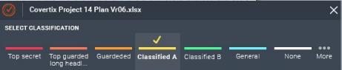
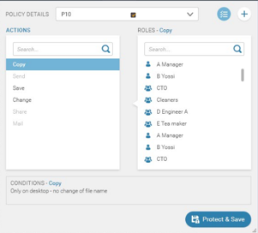
Mail Subject
ATTACHMENT CLASSIFICATION
ATTACHMENT CLASSIFICATION
ALL
ATTACHMENT NAME
POLICY
Finale Version_slide_28…
P10
email_bar_slide_41_04
P3
HLD Covertix v8 after GUI concept …
Open source
For single attachment – show the POLICY details
For single attachment – show the POLICY details
Policy type can be changed- the details will change accordantly
Policy type can be changed- the details will change accordantly
Re-Protect & Save

Slide 47
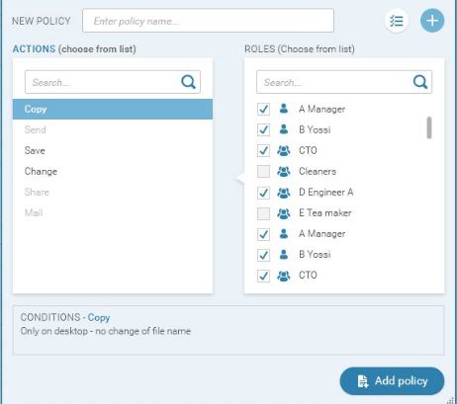
Mail Subject
ATTACHMENT CLASSIFICATION
ATTACHMENT CLASSIFICATION
ALL
ATTACHMENT NAME
POLICY
Finale Version_slide_28…
P10
email_bar_slide_41_04
P3
HLD Covertix v8 after GUI concept …
Open source
For single attachment – show the POLICY details
For single attachment – Create a new POLICY
Will open a separate dialog to choose new ROLES from
Will show all ROLES under the specific POLICY
The roles marked are the ones allowed to use the chosen ACTION (copy)
ROLES that will not be marked in any of the relevant ACTIONS will be automatically deleted

Slide 48
Mail – Attachments options
Multi attachments editing

Slide 49
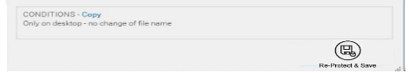
Multi attachments editing
Mail Subject
ATTACHMENT CLASSIFICATION
ATTACHMENT CLASSIFICATION
When choosing multi attachments the classification is “neutral”
ALL
ATTACHMENT NAME
POLICY
Finale Version_slide_28…
P10
email_bar_slide_41_04
P3
POLICY Details & add new will be disabled
HLD Covertix v8 after GUI concept …
Open source
POLICY Details & add new will be disabled
POLICY type will be “neutral”
Edit the chosen attachments POLICY

Slide 50
Multi attachments editing
Mail Subject
ATTACHMENT CLASSIFICATION
ATTACHMENT CLASSIFICATION
Choose a preferred CALSIFICATION
POLICY
ALL
ATTACHMENT NAME
Finale Version_slide_28…
P10
P3
email_bar_slide_41_04
P10
HLD Covertix v8 after GUI concept …
P10
Open source
P1
P4
P5
P6
P7
When pressed the POLICY type dialog is active
Suitable POLICYs type only

Slide 51
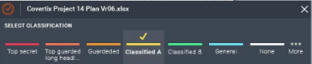
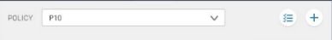
Mail Subject
ATTACHMENT CLASSIFICATION
ATTACHMENT CLASSIFICATION
ALL
ATTACHMENT NAME
POLICY
Finale Version_slide_28…
P10
email_bar_slide_41_04
P10
HLD Covertix v8 after GUI concept …
P10
POLICY details is active only after choosing POLICY type
Re-Protect & Save

Slide 52
Mail Subject
ATTACHMENT CLASSIFICATION
ATTACHMENT CLASSIFICATION
ALL
ATTACHMENT NAME
POLICY
Finale Version_slide_28_minimum_classifications_02
P10
email_bar_slide_41_04
P10
HLD Covertix v8 after GUI concept meeting 2
P10

Slide 53
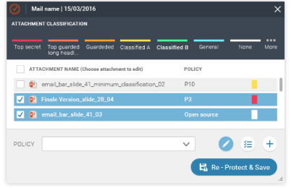
✓
ALL
P3

Slide 54
Mail Subject
ATTACHMENT CLASSIFICATION
ATTACHMENT CLASSIFICATION
ALL
ATTACHMENT NAME
POLICY
Finale Version_slide_28_minimum_classifications_02
email_bar_slide_41_04
HLD Covertix v8 after GUI concept meeting 2
Create new POLICY for MULTI attachments will become active only after choosing Edit
Create new POLICY for MULTI attachments will become active only after choosing Edit

